Slide 1


MINI PROJECT
PROJECT NAME- VASTRA [Ecommerce website]

Slide 2
vastra
Wear whatever you want

Slide 3
TEAM MEMBERS WORKING ON PROJECT
Devesh Yadav
Kartikeya Pandey
Priyanshu Tiwari
Shashank Yadav
Shivendra Pratap Singh

Slide 4

CONTENTS
Introduction
Existing System
Proposed System
Software Specifications
Modules

Slide 5
INTRODUCTION
VASTRA is an E-Commerce platform.
It offers cloths.
It offers the best price cloth compare to market.
It offers some new sorting features for seller.
It provide you case on delivery.

Slide 6
EXISTING SYSTEM
In the present System, users have some come sorting features from last 5 years .
The product return days calculate on normal basis..
Problems in the current system:-
Updates, changes in details is tiresome.
Performance is affected and not up to mark.

Slide 7
PROPOSED SYSTEM
The proposed system solves the issues faced by the current system.
Benefits:-
Data is centralized, so it will be recorded.
The updating and changes in details will be much easier.
Maintenance will get easier making it cost effective.
It will support multiple languages making it user friendly.

Slide 8
SOME MORE BENEFITS OF THE PROPOSED SYSTEM
Instant order confirmation through an email reminder.
Online payment available with some unique feature.
Accept payment by credit, debit cards without any extra online charges.
User will have warranty off there product though website.
Users can custom their cloth as they want.

Slide 9
SOFTWARE SPECIFICATIONS
Operation System : Windows, Linus, Android, iOS
User-Interface : HTML,CSS BOOTSTRAP
Client-side Scripting : JavaScript
Programming Language : PHP
Web Technologies. : JQUERY
Database : My SQL6
Database Connectivity : JDBC
Web Server : XAMPP/WAMPP/MAMP server

Slide 10
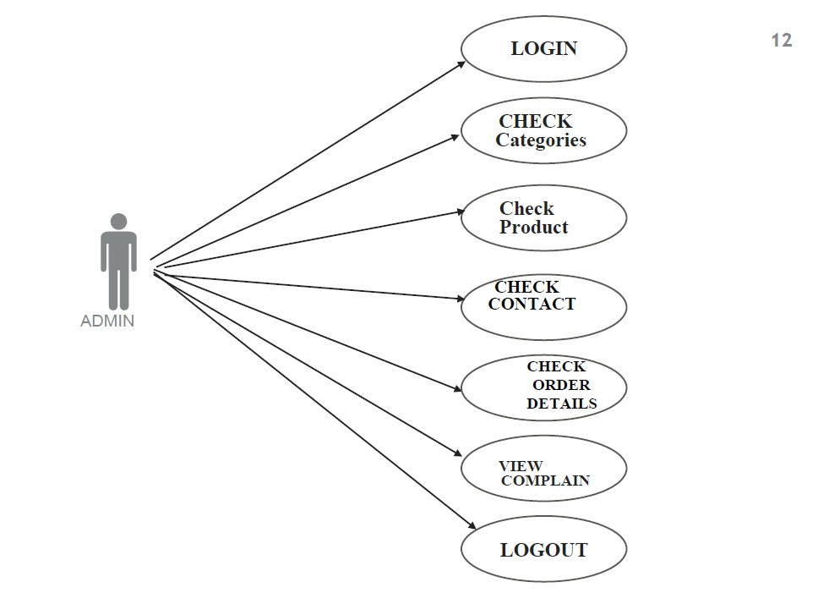
ADMIN: USE CASE DIAGRAM

Slide 11
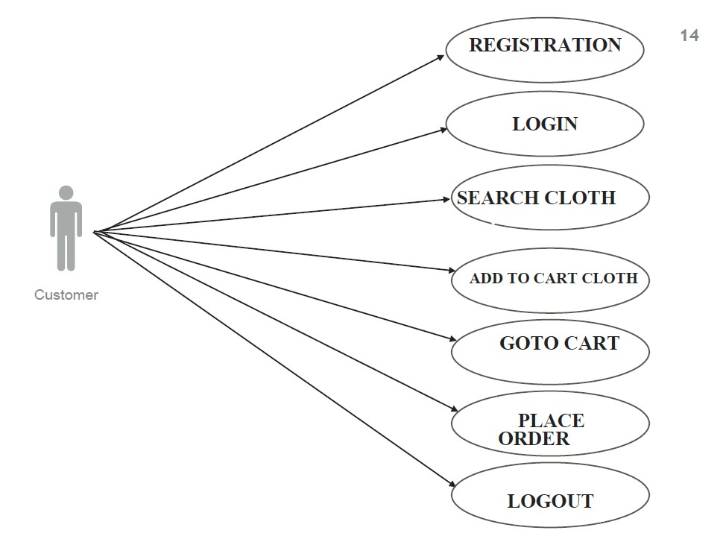
CUSTOMER: USE CASE DIAGRAM

Slide 12
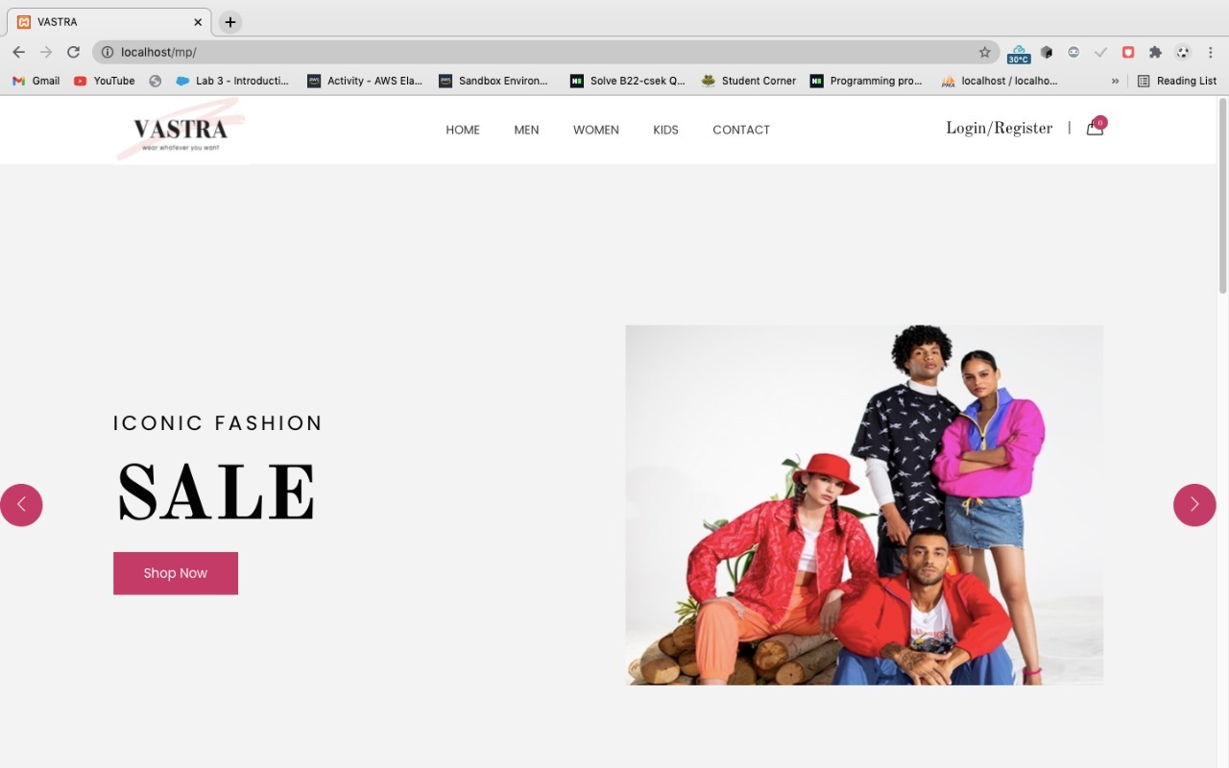
WEBSITE : HOMEPAGE

Slide 13
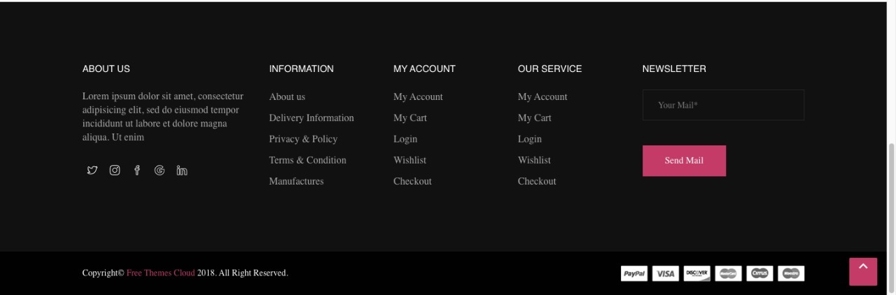
FOOTER OF WEBSITE

Slide 14
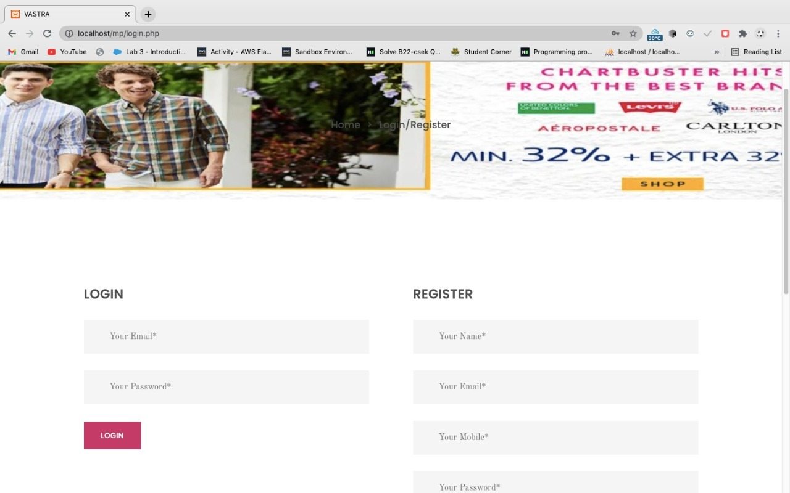
LOGIN/ REGISTER PAGE

Slide 15
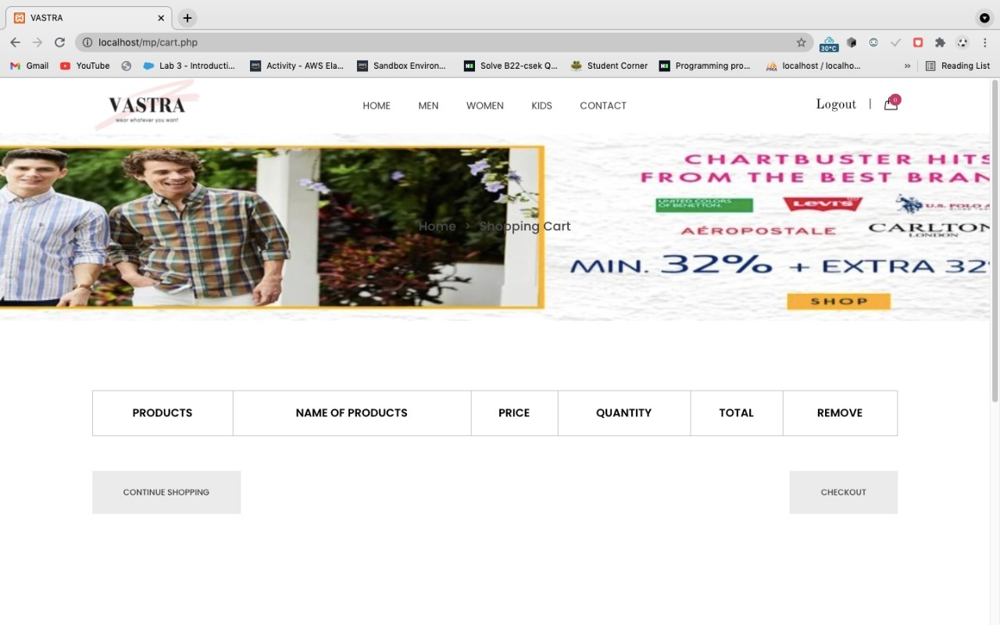
CART PAGE

Slide 16
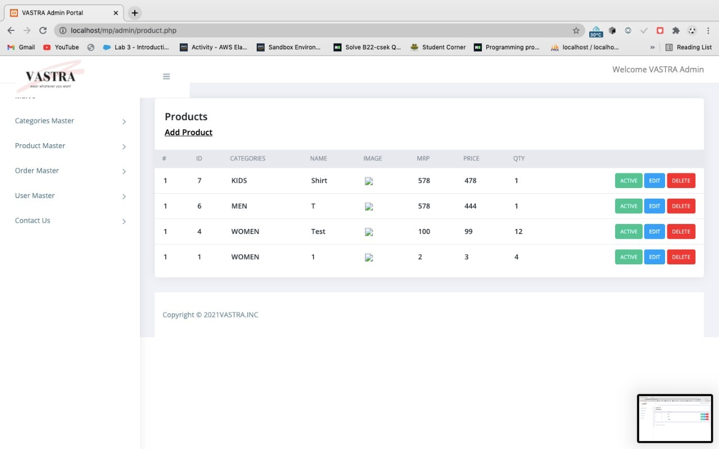
ADMIN: HOMEPAGE

Slide 17
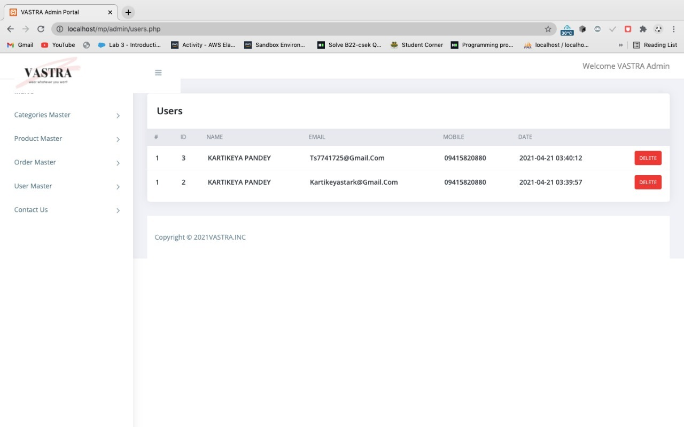
ADMIN : Customer detail

Slide 18
CONCLUSION
Vastra is a web application, and it is not restricted to only limited type of users.
In this application different type of users have been given access rights and they are restricted up to functionalities, so that data is maintained securely, and redundant data is prevented.
We are providing a good user interface.

Slide 19

THANK YOU

